Slide 1
D-APP FOR
ACCOUNTABILITY
FAZIAN-ABID-RASHID-TALHA

Slide 2


problem
Faced by stakeholders dealing with governments, charities & public companies when the funds are acquired & used for specific reasons
Accountability where did my money go & for what is it used?
Responsibility who specifically moved my money?
Transparency & Trust is it easy for me to acquire this knowledge? can i really trust the office?

Slide 3
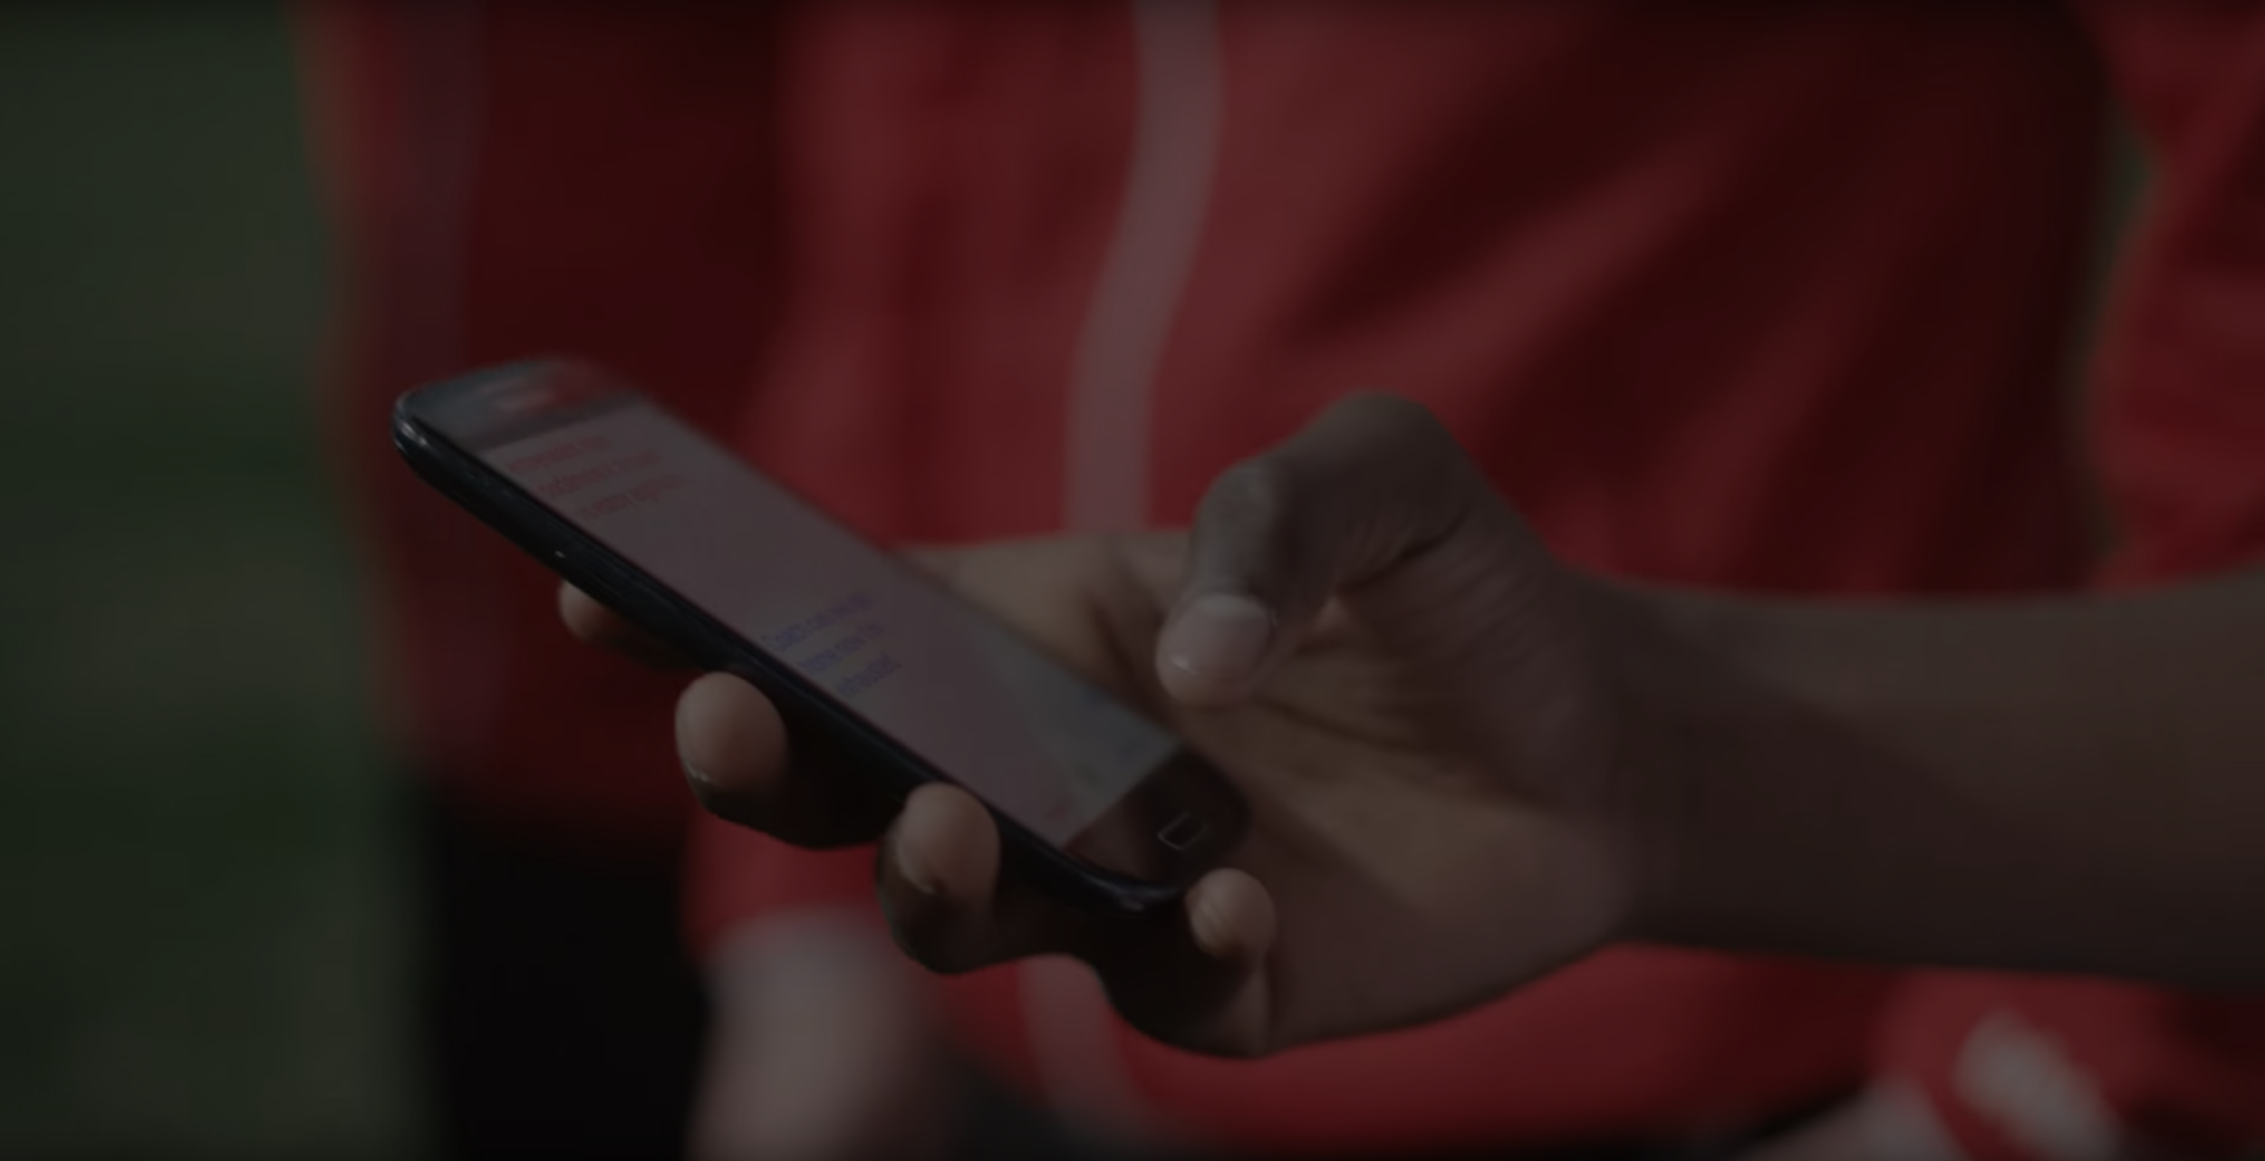
BLOCKCHAIN! Can help.
our system would ENGRAVE
the details of fund spendings between participants ON THE ETHEREUM BLOCKCHAIN
Complete audit trail
know where each of you $ is spent
trust is system-intrinsic

